Slide 1

Soft Skills
Gulnaz Ibragimova

Slide 2
Section 1 Personal brand and Soft skills
Topics covered in this section:
Soft skills and Networking
Self-confidence and Body language
Personal Brand
Making presentations
Leadership skills

Slide 3
Structure
Introduction/your expectations
Soft skills vs hard skills
Networking
Practice: Behavior based interview

Slide 4
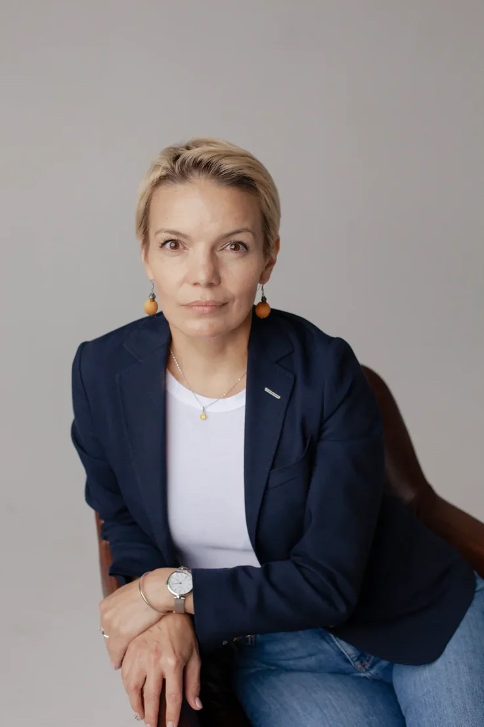
Introduction
Gulnaz Ibragimova
20+ years in IT industry
Degree in Education and Linguistics
Master’s Degree in Business Administration (MBA), UK
HR director for 8 years
Now Region Lead for UK and Oceania at GDC Fujitsu in Russia

Slide 5
Outcomes
by the end of the lessons you will learn:
what soft skills you need to be successful
why networking is essential for your career
how to deal with behavior based questions in an interview

Slide 6
Hard Skills
the specific knowledge, abilities and expertise required to do a particular job successfully
It is about your CV
Examples

Slide 7
Soft Skills
soft skills are more to do with
your personality
non-technical abilities
It is about your Cover Letter

Slide 8
Soft Skills
Can be fostered by observing and paying attention to others, self-reflection and proactive personal development.
Every job role requires some interactions with others, whether they are colleagues or customers,
SO
soft skills will be important to most employers

Slide 9
Soft Skills
Communications
Self-Motivation
Responsibility
Leadership
Teamwork
Decisiveness
Ability to Work Under Pressure and Time Management
Flexibility
Negotiation and Conflict Resolution

Slide 10
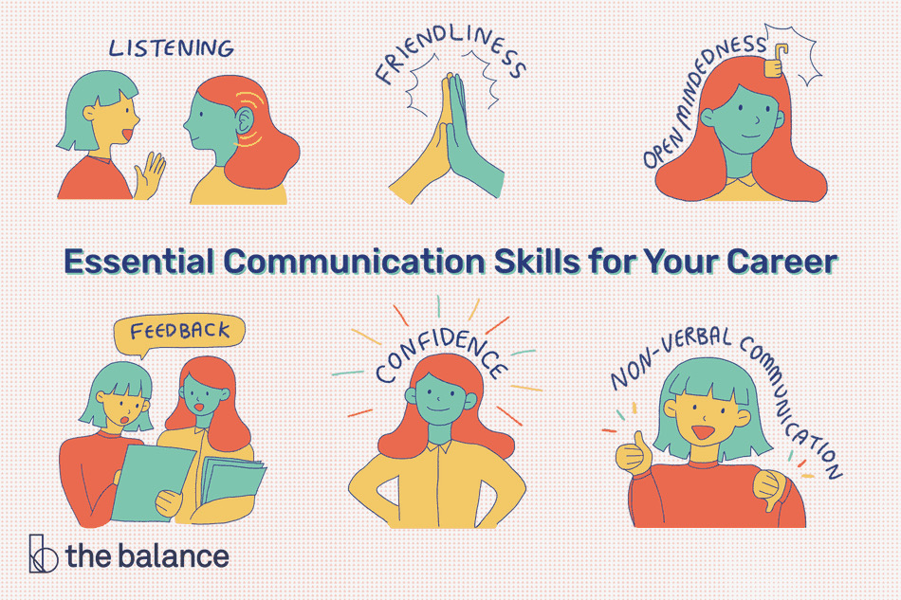
Communication is one of the most important soft skills

Slide 11
Self-motivation
Having a positive attitude and the initiative to work well without around-the-clock supervision is a vital soft skill for any employee
Positivity
Ambition
Commitment
Initiative

Slide 12
Responsibility
Taking responsibility means
taking ownership of not only your goals but the wider company goals. This will mean taking the initiative to make improvements, accepting responsibility for any failures and really caring about working your way to success.
Examples

Slide 13
Teamwork
Good team players are perceptive, as well as receptive to the needs and responsibilities of others.
Examples

Slide 14
Decisiveness
They take responsibility for the consequences of their decision and can adapt when mistakes are made. This ensures that opportunities aren't missed by lengthy analysis or debate
Examples

Slide 15
Ability to Work Under Pressure and Time Management
Many jobs come with demanding deadlines and, sometimes, high stakes
Examples

Slide 16
Flexibility
It demonstrates an ability and willingness to embrace new tasks and new challenges calmly and without fuss
Examples

Slide 17
Networking
Networking is essential for your careers
“Opportunities do not float like clouds in the sky. They’re attached to people. If you’re looking for an opportunity, you’re really looking for a person.”
— Reid Hoffman
Examples

Slide 18
PRACTICE: Behavior/Competency Based Interview
Competency-based interviews use questions which aim to find out how you have used specific skills in your previous experience and how you approach problems, tasks and challenges.

Slide 19
PRACTICE: Behavior/Competency Based Interview
S – situation 1 min
T – task 1 min
A – actions 3 min
R – results 1 min
Communications
Self-Motivation
Leadership
Teamwork
Decisiveness
Ability to Work Under Pressure and Time Management
Flexibility
Negotiation and Conflict Resolution

Slide 20
PRACTICE: Questions
Share a time you had communication problems with your manager or coworker. How did you handle the situation?
A time you had to deal with someone who was difficult
A problem you solved in a creative way or unique way

Slide 21

Q&A

